Slide 1

Introduction to Machine Learning
Topic 0 – Course Introduction
Master in Quantitative Economic Analysis MQuEA
Javier Bas
Universidad Autónoma de Madrid

Slide 2
Outline
Me
What this course is and what is not
References
Syllabus
Tools
Assessment
Master´s thesis
Master in Quantitative Economic Analysis MQuEA
Universidad Autónoma de Madrid

Slide 3


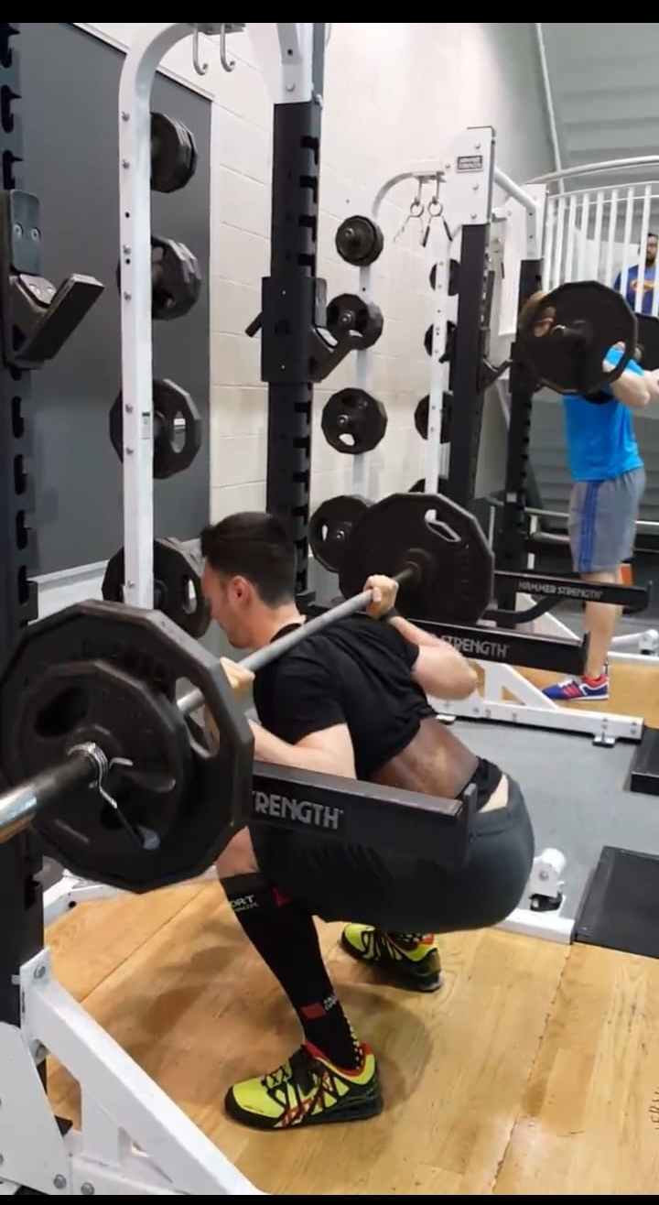




Me
Master in Quantitative Economic Analysis MQuEA
Universidad Autónoma de Madrid

Slide 4
What this course is and what it is not
What it is…
  A theoretical and practical introduction to Machine Learning methods
  A lab
  A safe environment to make mistakes
  A place to discuss, share and have fun while learning
What it is not…
  A coding course
Master in Quantitative Economic Analysis MQuEA
Universidad Autónoma de Madrid

Slide 5
References
James, G., Witten, D., Hastie, T., & Tibshirani, R. (2013). An introduction to statistical learning (Vol. 112, p. 18). New York: springer.
Géron, A. (2019). Hands-on machine learning with Scikit-Learn, Keras, and TensorFlow: Concepts, tools, and techniques to build intelligent systems. " O'Reilly Media, Inc.".
Müller, A. C., & Guido, S. (2016). Introduction to machine learning with Python: a guide for data scientists. " O'Reilly Media, Inc.".
VanderPlas, J. (2016). Python data science handbook: Essential tools for working with data. " O'Reilly Media, Inc.".
Master in Quantitative Economic Analysis MQuEA
Universidad Autónoma de Madrid

Slide 6
Syllabus
Topic 0 – Introduction to course
Part I - Basic stuff (~1 week)
Topic 1 – What is Machine Learning? (HO Ch. 1 / ISL Ch. 2)
Topic 2 – A Machine Learning Project (HO Ch. 2 / ISL Ch. 2)
Topic 3 – Resampling methods (ISL Ch. 5)
Part II - Supervised Learning (~4 weeks)
Topic 4 – Classification (HO Ch. 3, ISL Ch. 4)
Topic 5 – Tree-based Methods (HO Ch. 6 & 7)
Lab session #1
Lab session #2
Master in Quantitative Economic Analysis MQuEA
Universidad Autónoma de Madrid

Slide 7
Syllabus
Part III - Unsupervised Learning (~3 weeks)
Topic 7 – Dimensionality Reduction (HO Ch. 8 / ISL Ch. 10 / IMLP Ch. 3)
Topic 8 – Clustering (HO Ch.9, ISL Ch. 10)
Advanced topics (2 days)
Topic 6 – Neural Networks (HO Ch. 10)
Special guest
  Nommon
  TBA
  IAGen
Lab session #3
Lab session #4
Master in Quantitative Economic Analysis MQuEA
Universidad Autónoma de Madrid

Slide 8
Tools
Google Colab (https://colab.research.google.com)
IDEs (Visual Studio Code, Spyder, PyCharm, RStudio (Posit))
GitHub
Moodle
Master in Quantitative Economic Analysis MQuEA
Universidad Autónoma de Madrid

Slide 9
Assessment
Lab Sessions “groups” of 1-2 students: 40%
Final exam: 60%
Master in Quantitative Economic Analysis MQuEA
Universidad Autónoma de Madrid

Slide 10
Master’s thesis
Limited availability this year but open to supervise master’s thesis on ML topics.
I’m interested I the following topics, but feel free to propose your own research ideas:
  ML in Transportation
  ML in Trade
  ML in Finance
  XAI
Works must be innovative.
I am a demanding advisor.
Master in Quantitative Economic Analysis MQuEA
Universidad Autónoma de Madrid

